Slide 1
Strategic Training Executive Program (STEP) 2.0: The Three Varying Contexts
Kevin Etter, Andrew Gaydos, Dr. Franck Biayi, Dr. Regina Kouassi, Dr. Patricia Bobo
Moderated by: Rebecca Turner, USAID

Slide 2
Introductions–will hide slide later
Kevin Etter, GAVI Consultant, Project Leader and Chief Architect of STEP 2.0
Andrew Gaydos, Project Technical Officer GHSC-TA FTO Chemonics International-
Dr. Franck Biayi, Director PNAM DRC
Dr. Regina Kouassi , head of training DAP Cote d’Ivoire
Dr. Patricia Bobo, Ag Director Public Health & Research Ministry of Health Zambia
Jo Tierens, Senior Director Global Public Health Supply Chain
Alexis Strader, Senior Manager, Project Management and Strategy Lead Global Public Health Supply Chain
Notes:
Intros:
Kevin- Kevin Etter is a logistics expert with over xx years experience. His career started with UPS and he now serves as a consultant for GAVI and PtD on STEP 2.0.
Andrew Gaydos- Andrew is a Technical Officer on the GHSC-TA FTO project with Chemonics International, focusing on supporting local government partners in Francophone countries to improve their capacity to manage in-county pharmaceutical supply chains.
Dr. Franck Biayi- Dr. Franck is the Director of the DRC version of the FDA, where he leads efforts to strengthen in-country supply chains.
Dr. Kouassi- Dr. Kouassi is the Director of Training and Learning based at the DAP, where she leads all efforts to improve MoH capacity in supply chain and health management.
Dr. Patricia Bobo- To be added by Dominique.
Jo Tierens, Senior Director Global Public Health Supply Chain J&J
Alexis Strader, Senior Manager, Project Management and Strategy Lead Global Public Health Supply Chain J&J

Slide 3
Agenda
Step 2.0–The Programme Background
The DRC Experience
The Côte d’Ivoire Experience
The Zambia Experience
Hearing from the Coaches
Audience Q&A

Slide 4
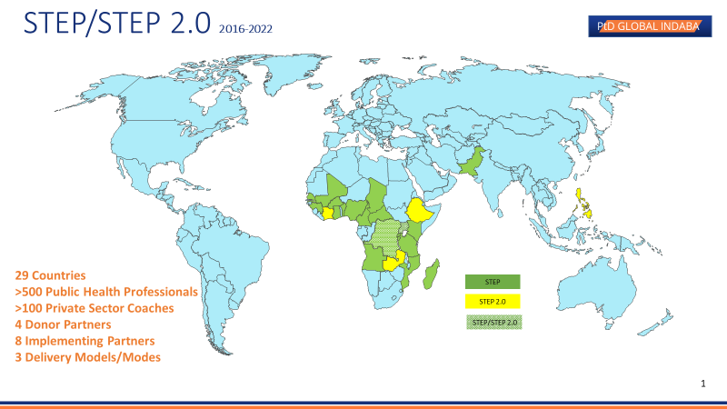
4

Slide 5
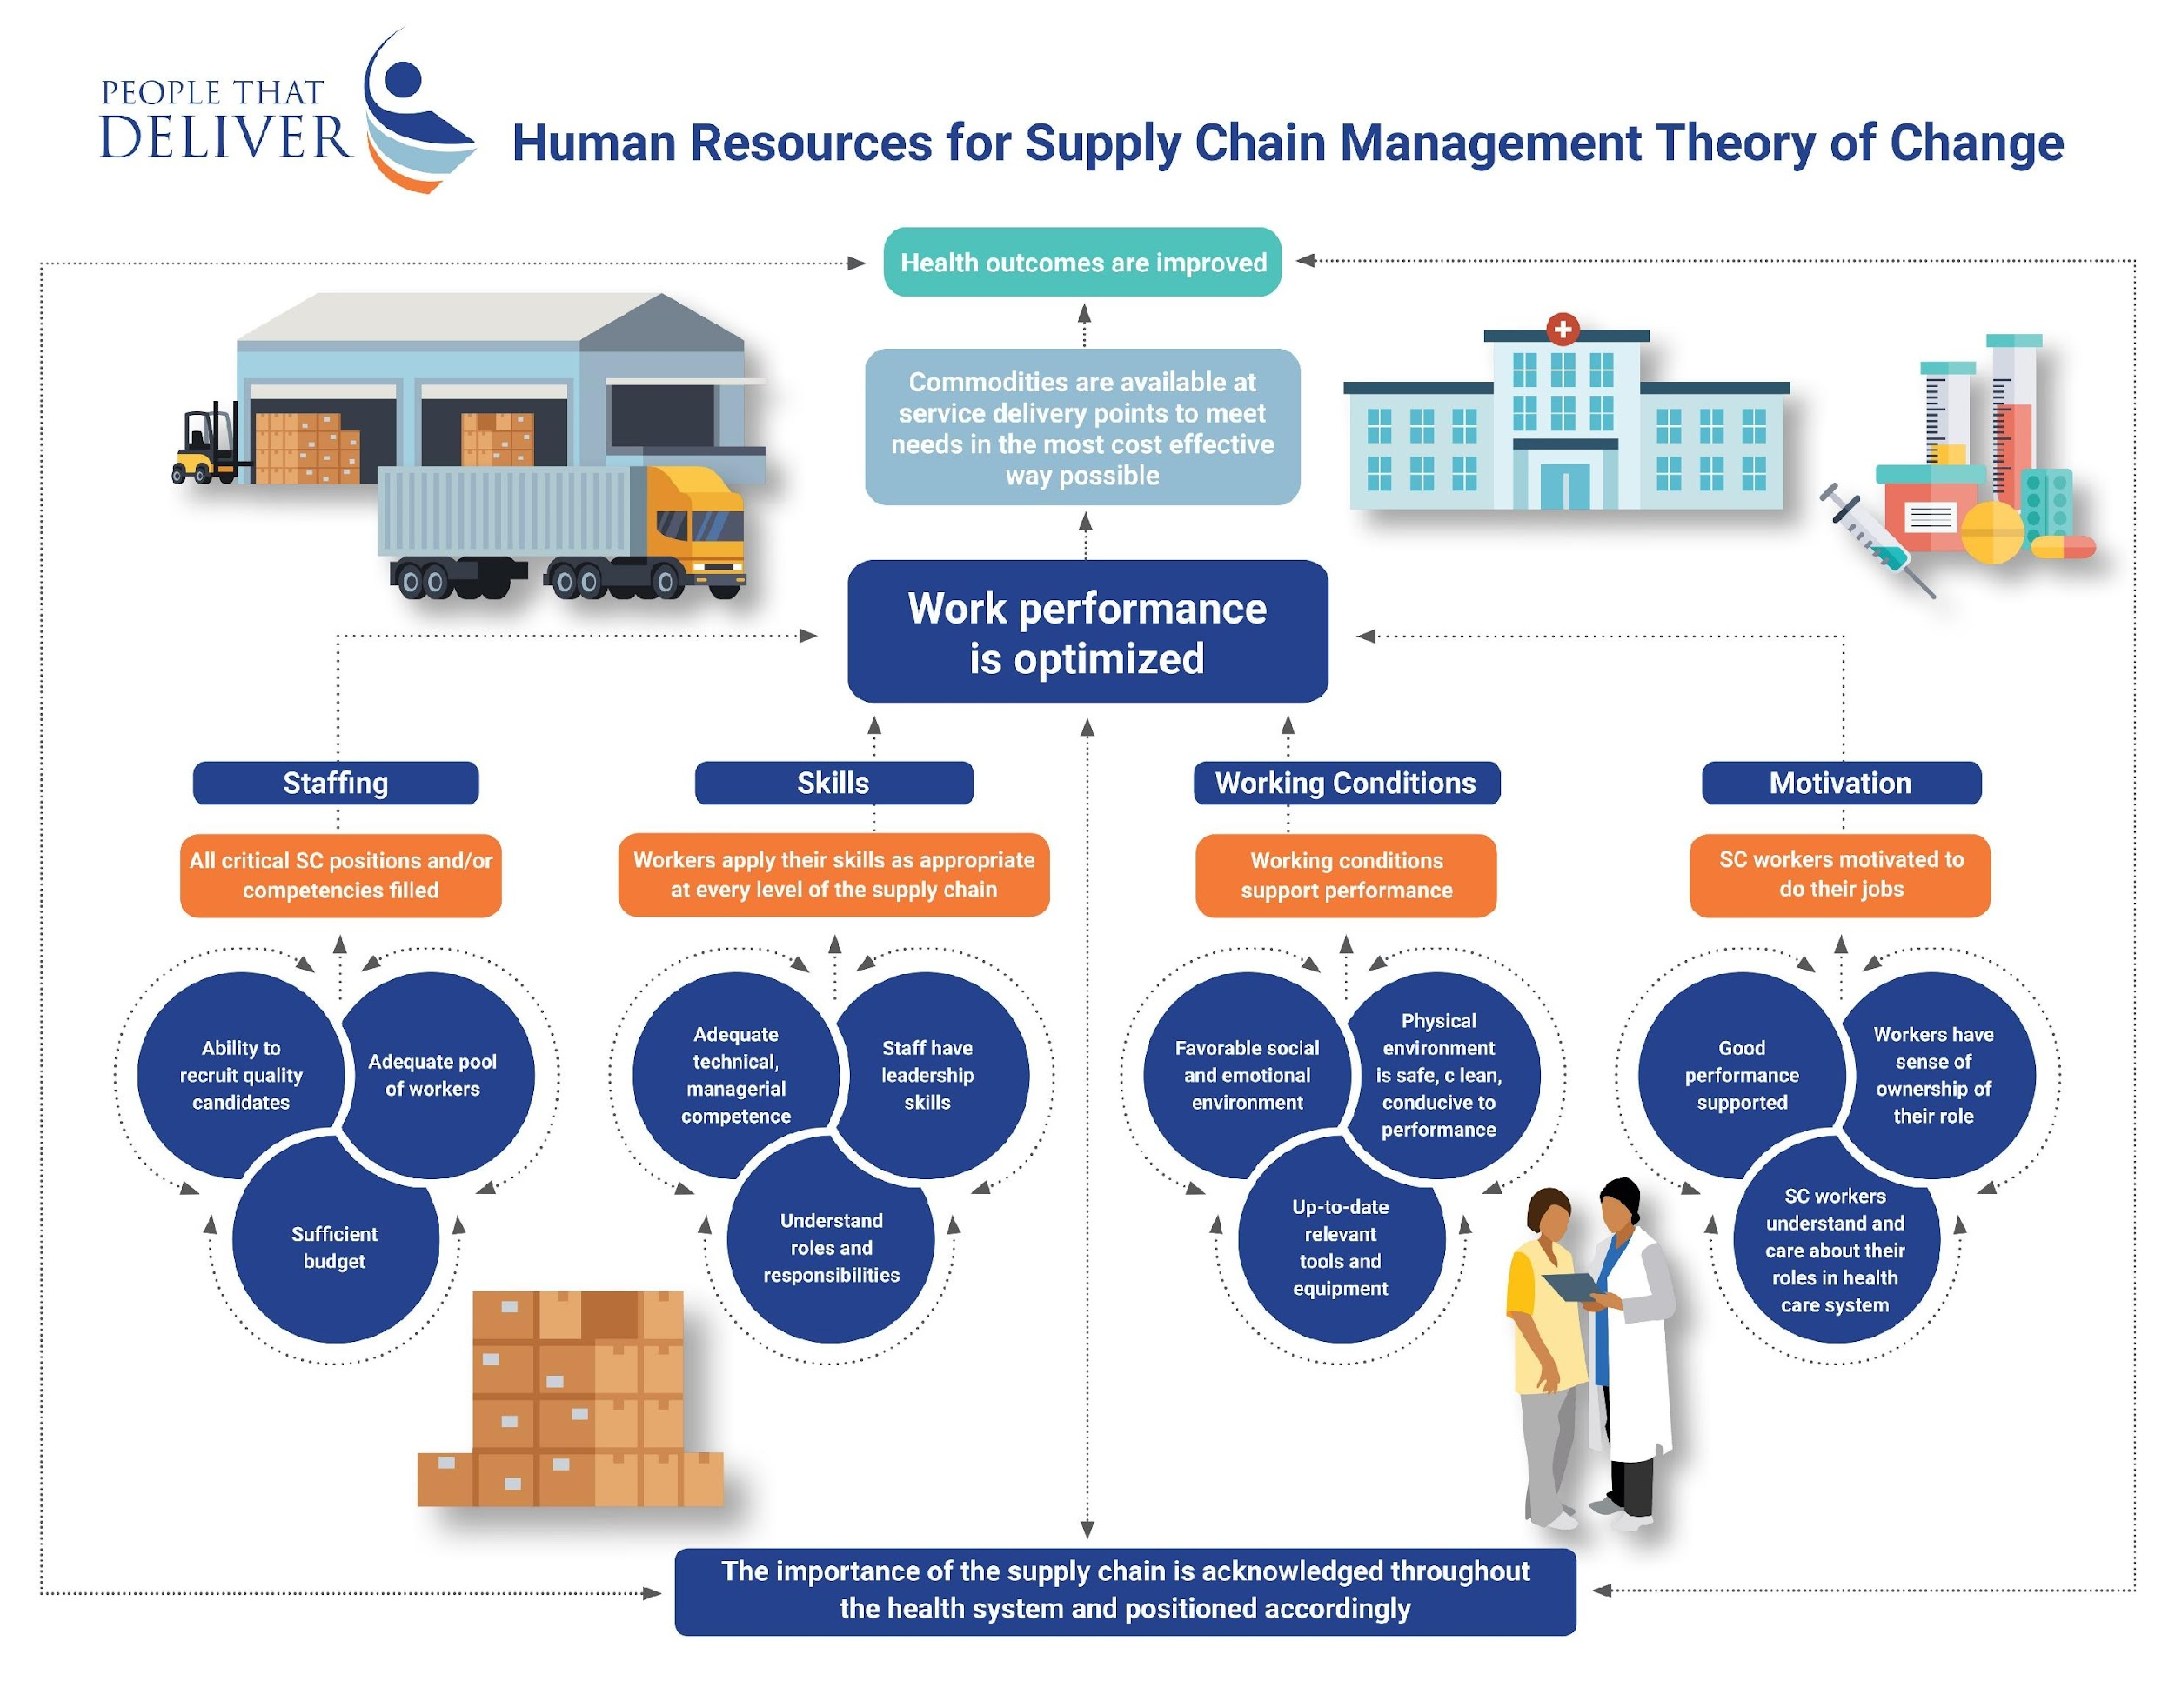
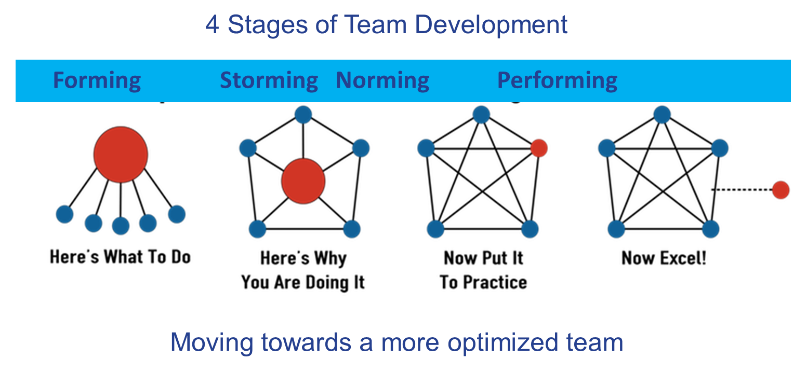
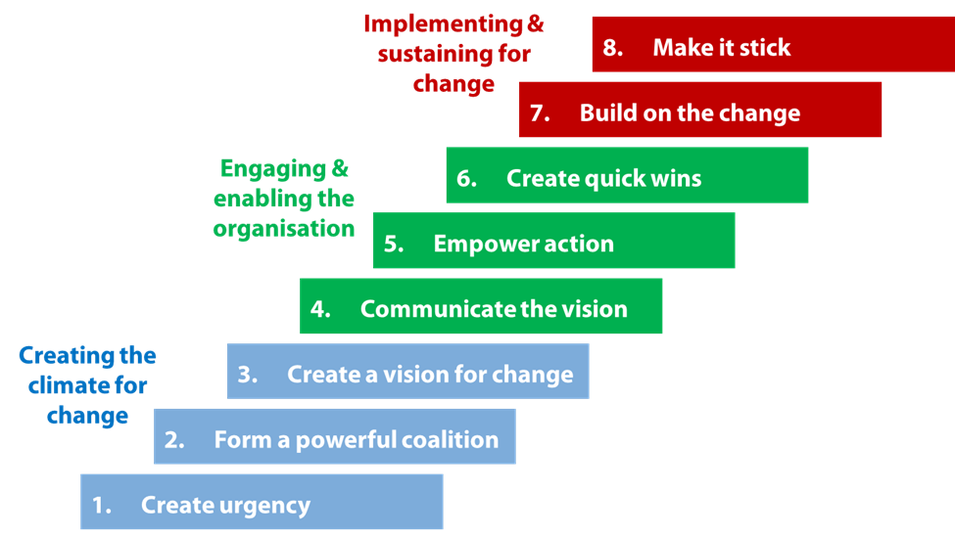
The STEP Experience Program Principles, Assumptions, Content and Curriculum
Strategic Training Executive Program
Strategic Transformation Experience Program
Strategic Team Engagement Program
STEP 2.0 is a PUBLIC PRIVATE PARTNERSHIP intended to bridge the best practices of both Public and Private Health Professionals through collaborative, team-based problem-solving leadership principles to solve operational challenges that have defied resolution in the past.
The Models: Theory of Change Leadership Development Change Management
STEP 2.0 is built around two core principles, the first is that adults learn best by immersion into facilitator guided peer-to-peer experiences and simulations.
The second is the concept that adult learning is best experienced through inputs from multiple, diverse sources and voices.
The Many Voices Model
Individual Self-Directed Study, Private Sector Coaching (both team and individual), Staff/Faculty Coaching (both team and individual), Multiple Facilitators,
Plenary Presentations, Technical Timeouts, Facilitated Discussions, Team Exercises, Team Breakouts, Individual Presentations, Stakeholder Presentations

Slide 6
STEP 2.0 MODES OF DELIVERY
Step 2.0 is an innovative change management process embedded in a 21st century “team-based” leadership development program designed to solve 21st century challenges.
Traditional Model STEP 2.0
PERSONAL AND OPERATIONAL TRANSFORMATION
3 MONTH TRANSFORMATION CHALLENGE IMPACT PERIOD
PROGRAM WORKSHOP
5 DAY F2F COLLABORATIVE PROBLEM -SOLVING SKILLS WORKSHOP
Virtual Model vSTEP 2.0
PERSONAL AND OPERATIONAL TRANSFORMATION
3 MONTH TRANSFORMATION CHALLENGE IMPACT PERIOD
PROGRAM PREPARATION
6 PERSONAL CHALLENGE IDENTIFICATION ASSIGNMENTS
PROGRAM VIRTUAL WORKSHOPS
13 VIRTUAL COLLABORATIVE PROBLEM -SOLVING SKILLS LESSONS
6 INDIVIDUALIZED VIRTUAL COACHING SESSIONS
PERSONAL AND OPERATIONAL TRANSFORMATION
3 MONTH TRANSFORMATION CHALLENGE IMPACT PERIOD
Hybrid Model hSTEP 2.0
PROGRAM PREPARATION
6 PERSONAL CHALLENGE IDENTIFICATION ASSIGNMENTS
PROGRAM VIRTUAL WORKSHOPS
13 VIRTUAL COLLABORATIVE PROBLEM -SOLVING SKILLS LESSONS
6 INDIVIDUALIZED IN PERSON COACHING SESSIONS
PROGRAM PREPARATION
6 PERSONAL CHALLENGE IDENTIFICATION ASSIGNMENTS

Slide 7
These organisations contributed their time, guidance and curriculum during the development of STEP 2.0
If you are building a collaborative, team-based problem-solving leadership program to solve operational challenges that have defied resolution in the past and a program whose inputs are expected to be from multiple, diverse sources and voices, it is best to assemble a powerful coalition of contributors!
Gavi, the Vaccine Alliance
USAID
The Global Fund to Fight AIDS, Tuberculosis and Malaria
UNICEF
WHO
The People that Deliver (PtD)
PATH
Villagereach
Sabin Vaccine Institute
Africa Resource Centre
The University of Global Health Equity
International Federation of Pharmaceutical Wholesalers (IPFW)
GSK
Johnson and Johnson
UPS
Obrigado
Thank you
Merci

Slide 8
Experience RDC

Slide 9
Project Timeline
Phase | Main Activities | Timeline
Phase 1 – Participation and Coach Selection | Confirm participation selection with PNAM Establish learning contacts with STEP participations, with sign off from PNAM Identify Transformational Challenge Projects with PNAM Identify and select local / regional private sector coaches* with support from IPFW, STEP Hub, Chemonics and PNAM | 1st March – 30th March
Phase 2 – E-Learning platform configuration and Preparatory Module Preparation | Configure learning platform, upload French-translated STEP materials, ensuring that eLearning content is available to all participants Conduct a 1.5-day train-the-trainer workshop to give facilitators a hands-on crash course in delivering high impact live training Organize 0.5 day Coach Training to train on the skills needed to tactfully assist participants Introduce participants to coaches via virtual meeting Support Delegates and Coaches in completion of preparatory e-Learning materials, following up as required | 9st March – 12th April
Phase 3 - 5 Day Workshop Preparation and Execution | Organize logistics for 5 Day Workshop Use a learner-centered approach for content delivery during 5-day workshop to maximize delegate participation Collect daily feedback from participants and delegates | 12th April – 22nd May
Phase 4 – Transformational Challenge and Certification | Host 3 Transformational Challenge Live Check-ins: Live Kick Off, Live Mid-Point Check-in, Live-Pre Deadline Check-in (Optional) ]Organize a virtual Transformational Challenge final presentation session with delegates and coaches for share out of challenge findings and results Conduct delegate certification process upon satisfactory completion of STEP 2.0 training program (with sign off from coaches, PNAM and Chemonics) | 27th May – 30th August

Slide 10
Participants
Participant (Organization)
Frank Biayi (PNAM)
Jean Nanga (pnam)
Dieu Merci Maseke (PNLS)
Ethel Mbuy Mawab (Division of Health- Kinshasa)
Adelard KAZADI (CAMELU)
Odette Kangola Masangu (IGS)
Jean Pascal Ngomakuku (Division of Kwilu)
Gloria Lumu (PNLP)
Gilbert Amisi (PNAM)
Coach (Organization)
Cyrile Konde (DHL)
Christian Kashala (ISS Global Forwarding)
Delphin Ngoy Mwilambwe (World Vision)
Rodrigues Tuti Makana (Single Window for Foreign Trade)
Desire Mumbata (NIA Group)

Slide 11
Transformational Challenge Topics
Transformational Challenge | Objective | Participant | Coach
Stock out of anti-malaria commodities in HF within Kenge Health Zone | Improve reporting rate of Commodities to improve availability of anti-malarial commodities | Gloria Lumu | Delphin Ngoy
HR Management in the Supply Chain | Improve motivation of HR in supply chain management | Adelard Kazadi | Cyrille Konde

Slide 12
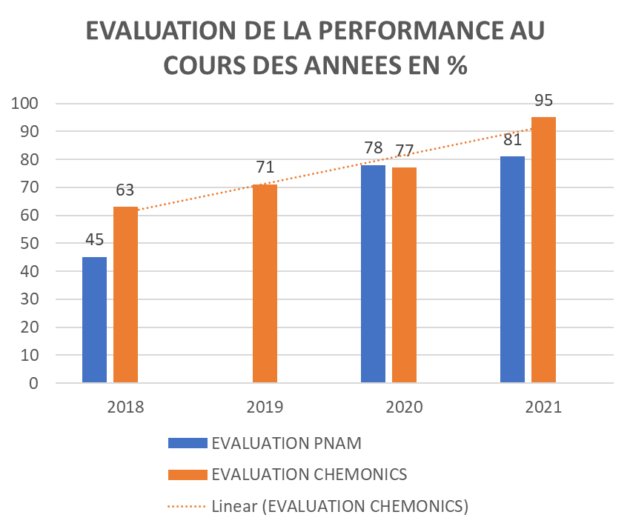
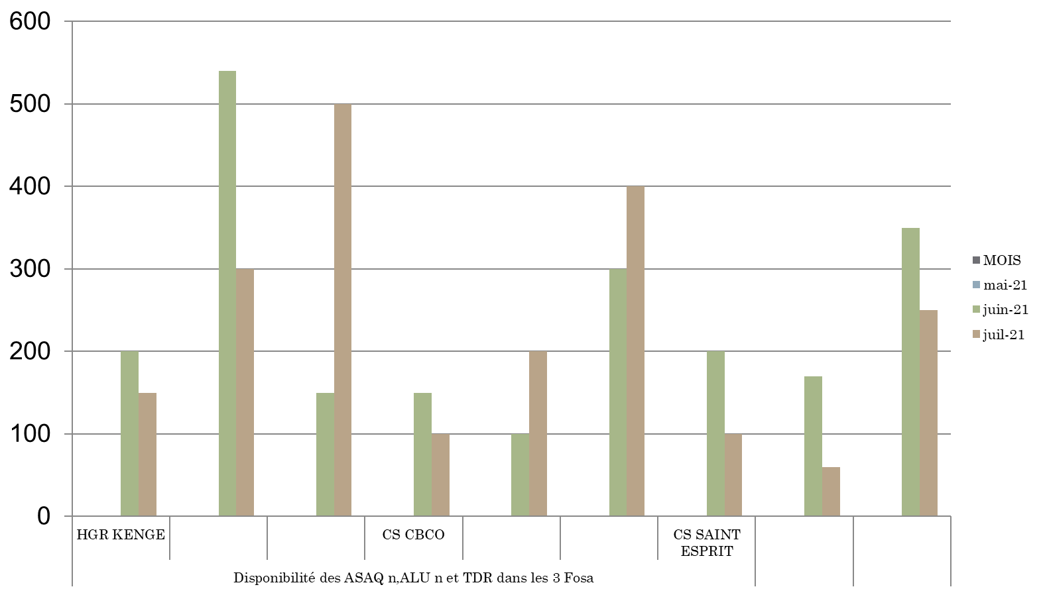
Results/ Next Steps
Notes:
Graph 1: Results in CAMELU.

Slide 13
Questions
Quels sont les grands défis à relever dans le pays, et comment est-ce que le STEP 2.0 vous a aidé à combattre ces défis?
Quelles sont les prochaines étapes dans votre pays?
Dans le futur, comment pensez- vous que des programmes comme STEP 2.0 peuvent être améliorés? Comment institutionnaliser votre pays?

Slide 14
Experience Côte d’Ivoire

Slide 15
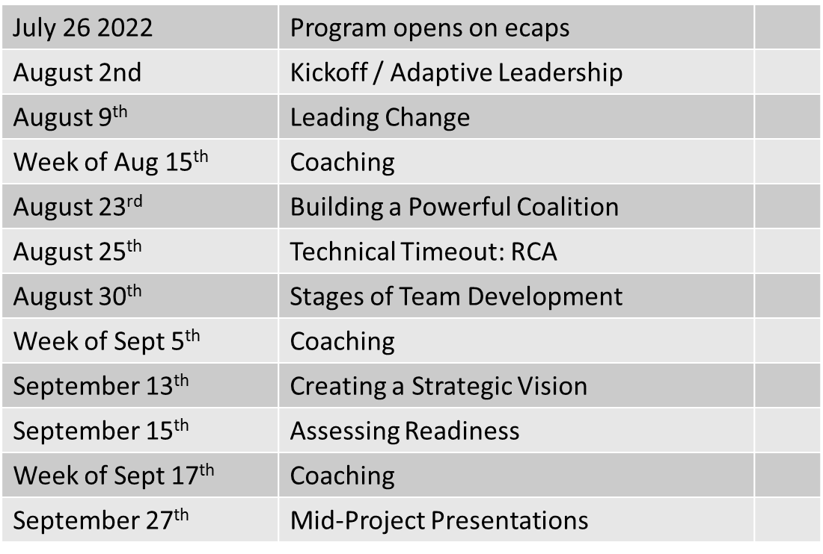
Project Timeline
October 4 | Effective communication
October 11 | Understanding and Removing Barriers and Advocacy for Change
Week of October 17 | Coaching
October 25 | Generating Short-Term wins
November 1 | Build on the change
Week of November 7 | Coaching
November 22 | Sustaining the Chance
November 24 | Technical Timeout
November 25 | Coaching
November 30 | Coaching
December 6 | Final presentations
December 13 | Graduation

Slide 16
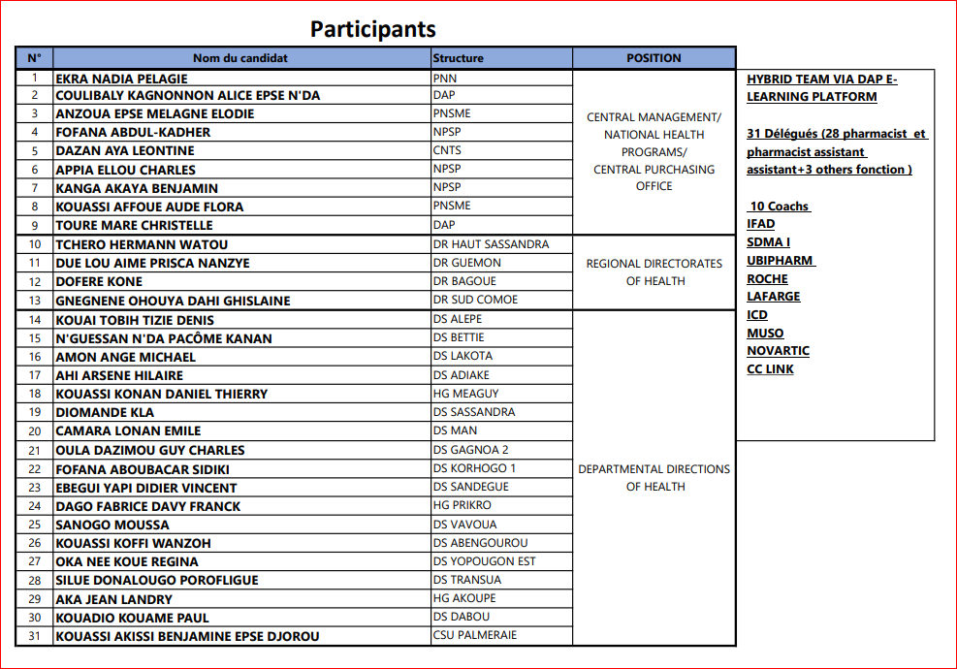

Slide 17
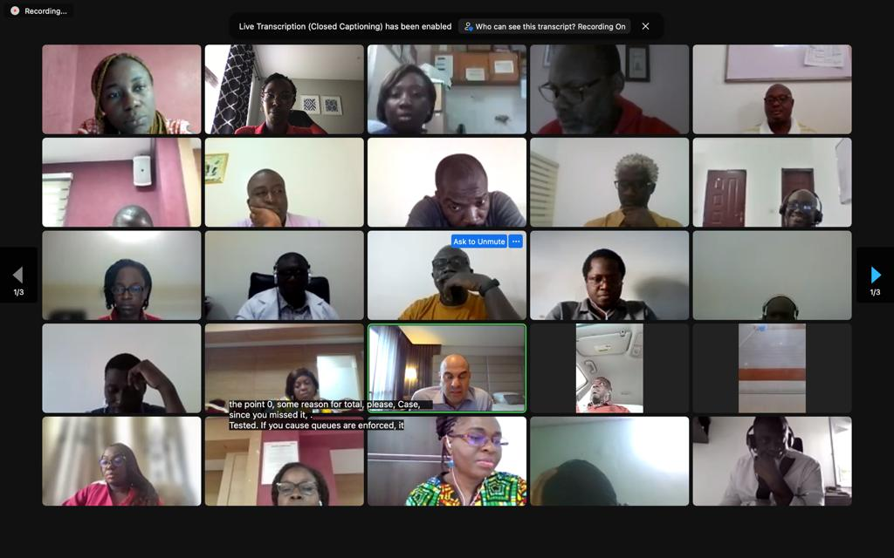
Photo of launching ceremony

Slide 18
Transformational Challenges
Improve last mile distribution (9)
the low distribution rate of districts to the ESPCs
Availability of products (tracer products)
Improve data reporting (15)
the quality of the data
Timely delivery of reports
Others (7)
the low rate of implementation of coordination activities at the regional level

Slide 19
Results/ Next Steps
With presentation of transformational challenges (September 27th), next step focuses on how to achieve intended goal (generating short term wins, communicating goals).
Next three months will focus on implementing materials learned into action to conquer transformational challenge.
Final results presentation scheduled for December 13.

Slide 20
Questions
Quels sont les grands défis à relever dans le pays, et comment est-ce que le STEP 2.0 vous a aidé à combattre ces défis?
Avec l'activité en cours en Côte d’Ivoire, quels sont les résultats déjà vus et la valeur du projet jusqu'à maintenant?
Quelles sont les prochaines étapes dans votre pays?
Dans le futur, comment pensez- vous que des programmes comme STEP 2.0 peuvent être améliorés? Comment institutionnaliser le programme STEP 2.0 dans votre pays?

Slide 21
Zambia’s Experience

Slide 22
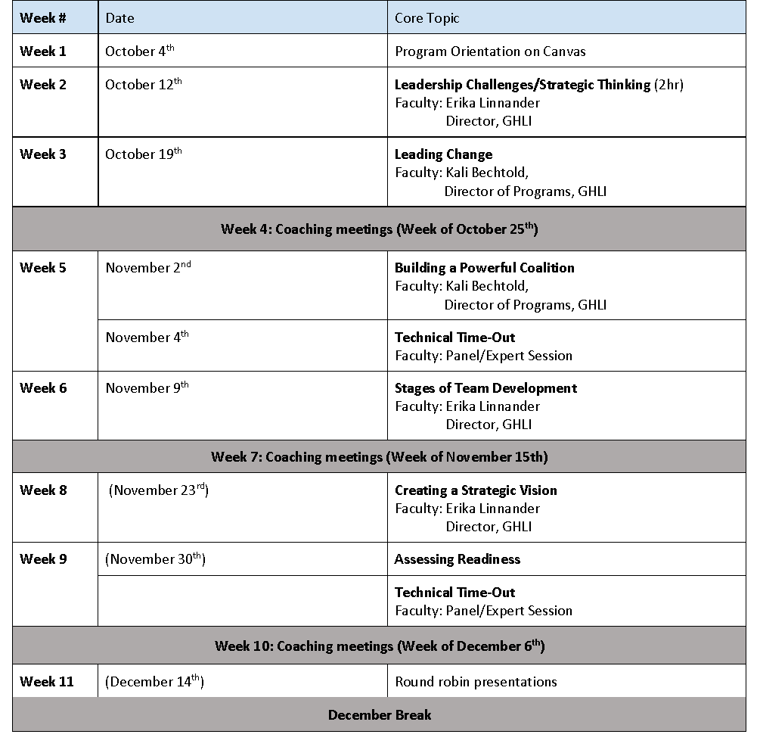
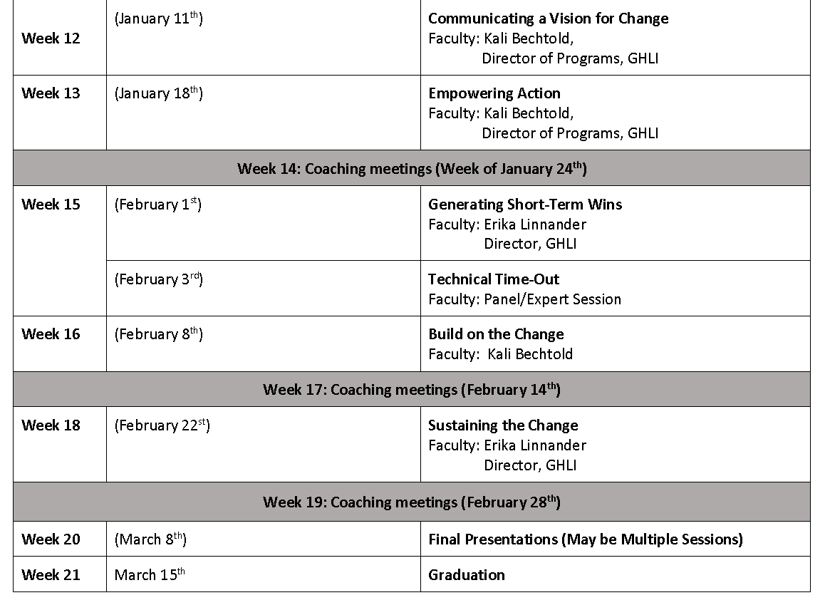
Project Timeline: vSTEP 2.0 (virtual program delivery)

Slide 23
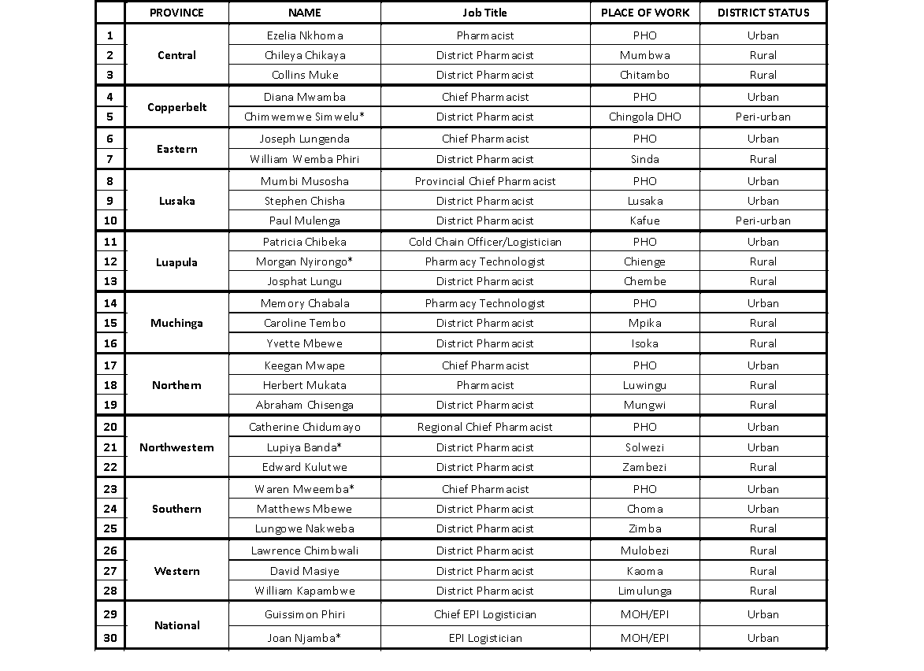
Virtual Delivery via Zoom/Teams
30 Public Health Participants
Pharmacists
Chief
District
Logisticians
Cold Chain Officer
EPI
(25 successfully completed the program – 83%)
6 International Coaches
J&J
GSK
Merck
10 Provinces + Central

Slide 24
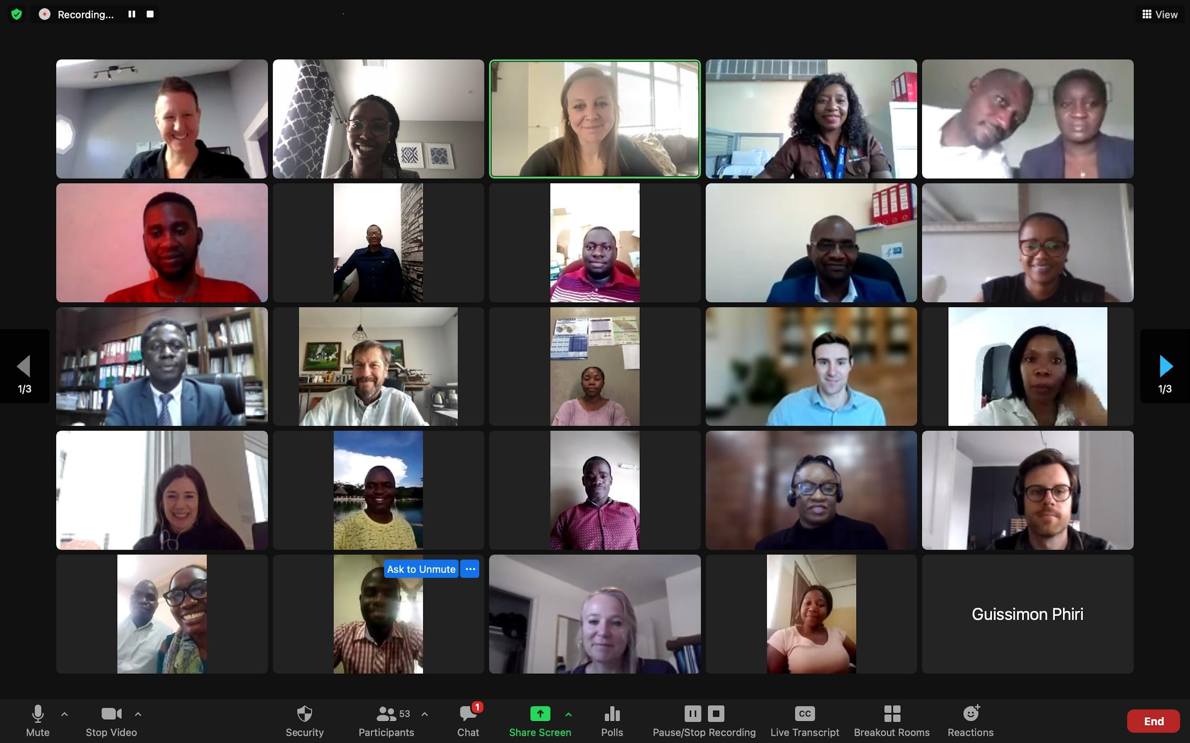
Group Photo

Slide 25
Transformation Challenges
General topics covered by our participants:
COVID-19 Response: Improving COVID-19 vaccination coverage (4)
Logistimo Utilization for management of immunization data (7)
Management of vaccine Stockouts (7)
Management of Cold Chain Equipment (3)
Vaccine Wastage (2)
Government Funding (1)
Staff Retention (1)

Slide 26
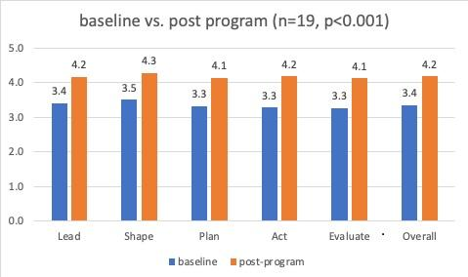
Results Personal Competency Impact

Slide 27
Questions for Dr. Patricia
What sparked Zambia’s interest in STEP?
What was the greatest impact you saw from this program?
What key areas should other countries consider when deciding on a Leadership development program?
What is the future of STEP in Zambia in terms of future iterations thoughts around future involvement from a coaching and participant perspective.

Slide 28
Hearing from the Private Sector Coaches…
STEP 2.0 is a PUBLIC PRIVATE PARTNERSHIP intended to bridge the best practices of both Public and Private Health Professionals through collaborative, team-based problem-solving leadership principles to solve operational challenges that have defied resolution in the past.
STEP’s success relies on coaches. These coaches are “skills-based (expert) volunteers” from multinational and regional private sector (business/commercial) contributors.
Leadership and technical capacity building programs like STEP provide a “safe space” for private sector contributors to engage the public sector in a “non-conflict of interest” way.
Each STEP offering seeks to include private sector volunteers from multiple private sector contributors across multiple disciplines.
Jo Tierens and Alexis Strader from Johnson and Johnson (J&J)
Notes:
What motivates the private sector to engage with the public sector through programs like STEP?
How do programs like STEP fit into organization’s Corporate Social Responsibility (CSR) goals and, more recently, organizations Environment, Social and Governance (ESG) goals?
How is STEP’s reliance on private sector “skills-based (expert) volunteers” sustainable and scalable?
What do the volunteers get from the program?
How did J&J support vSTEP 2.0 in Zambia?
Did the program’s results meet J&J’s expectations?
Did J&J’s participation meet Zambia’s expectations?KEVIN TO ADD QUESTIONS

Slide 29
Pre-baked for Audience Q&A
Dr. Patricia and Dr. Franc, how are you thinking through multi year implementations as well as the impact that may not be seen until years following the course?
FR: Dr. Patricia et Dr. Franc, comment seriez-vous en train de penser sur l’implementation multi-ans, et aussi sur l’impact qui n’etait pas tout a fait evident jusqu’aux annees apres l’implementation de STEP 2.0?
And for Andrew and Kevin, how are you thinking through challenges with measurement given that impacts from the course may occur years after the course concludes?
In addition, there are ongoing STEP 2.0 programmes ongoing in Uganda through EMPOWER School of Health. Kevin, how does this implementation match or is different from previous implementations of STEP 2.0? What are some of the results and next steps?

